Slide 1
Steganography with Image Encryption
CAPSTONE PROJECT
Presented By: KARTHICK S
Student Name : KARTHICK S
College Name & Department : SRM Institute of Science and Technology & MCA

Slide 2
OUTLINE
Problem Statement
Technology used
Wow factor
End users
Result
Conclusion
Git-hub Link

Slide 3
Problem Statement
With the increasing need for secure communication, traditional encryption methods are often easily detectable. This project aims to implement a steganography tool that allows users to securely hide a message within an image, ensuring covert data transmission. The message can only be retrieved using a password, adding an additional layer of security.

Slide 4
Technology used
Python - Core programming language for implementation.
OpenCV (cv2) - Image processing library to manipulate image pixels.
NumPy - Used for efficient numerical operations on image data.
OS Module - Handles file operations for saving and opening images.

Slide 5
Wow factors
Stealth Mode - Encrypted images look just like regular images.
Foolproof Security - Message retrieval is impossible without the correct password.
No Additional Storage Needed - Hides messages inside existing images without increasing file size significantly.
Quick Execution - Encodes and decodes messages in seconds.
Easy-to-Use - Simple command-line interface for effortless encryption and decryption.

Slide 6
End users
Journalists & Whistleblowers - Securely transmit confidential information without detection.
Cybersecurity Professionals - Demonstrate steganography techniques for security awareness.
Privacy Enthusiasts - Protect personal messages from unauthorized access.
Researchers & Educators - Use as a learning tool for encryption and steganography concepts.
Government & Military Personnel - Covertly transmit classified messages.

Slide 7
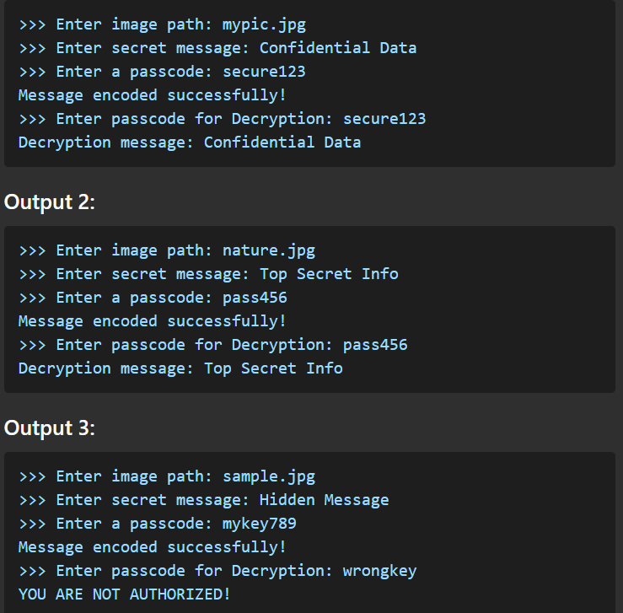
Results

Slide 8
Conclusion
Steganography is a powerful technique that enhances secure communication by embedding messages within images. This project demonstrates a simple yet effective approach to achieving hidden data transmission with password protection. The ability to encode and decode messages within an image while maintaining its integrity makes this method both practical and secure. Whether for privacy, security research, or educational purposes, this tool provides a foundational implementation of modern steganographic techniques.

Slide 9
GitHub Link
Make sure that there should be readme file
https://github.com/karthi535/stegno.git

Slide 10
THANK YOU

